Slide 1
Class Diagram

Slide 2
UML Class Diagram gives an overview of a software system by displaying classes, attributes, operations, and their relationships. This Diagram includes the class name, attributes, and operation in separate designated compartments.

Slide 3
Essential elements of UML class diagram are:
Class Name
Attributes
Operations

Slide 4
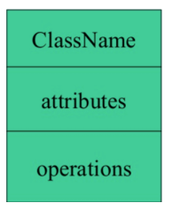
Class Name

Slide 5
Relationships
There are mainly three kinds of relationships in UML:
Dependencies
Generalizations
Associations

Slide 6
Dependency
A dependency means the relation between two or more classes in which a change in one may force changes in the other. However, it will always create a weaker relationship. Dependency indicates that one class depends on another.

Slide 7

In the following example, Student has a dependency on College

Slide 8
Generalization:
A generalization helps to connect a subclass to its superclass. A sub-class is inherited from its superclass. Generalization relationship can't be used to model interface implementation. Class diagram allows inheriting from multiple superclasses.

Slide 9
Association:
This kind of relationship represents static relationships between classes A and B. For example; an employee works for an organization.
Here are some rules for Association:
Association is mostly verb or a verb phrase or noun or noun phrase.
It should be named to indicate the role played by the class attached at the end of the association path.
Mandatory for reflexive associations
In this example, the relationship between student and college is shown which is studies.

Slide 10
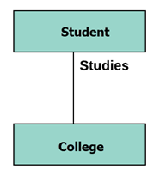

Slide 11
MultiplicityA multiplicity is a factor associated with an attribute. It specifies how many instances of attributes are created when a class is initialized. If a multiplicity is not specified, by default one is considered as a default multiplicity.
Let's say that that there are 100 students in one college. The college can have multiple students.

Slide 12
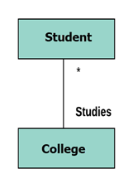

Slide 13
Aggregation
Aggregation is a special type of association that models a whole- part relationship between aggregate and its parts.

Slide 14

For example, the class college is made up of one or more student. In aggregation, the contained classes are never totally dependent on the lifecycle of the container. Here, the college class will remain even if the student is not available.

Slide 15
Composition:
The composition is a special type of aggregation which denotes strong ownership between two classes when one class is a part of another class.

Slide 16

For example, if college is composed of classes student. The college could contain many students, while each student belongs to only one college. So, if college is not functioning all the students also removed.

Slide 17
Aggregation vs. Composition
Aggregation | Composition
Aggregation indicates a relationship where the child can exist separately from their parent class. Example: Automobile (Parent) and Car (Child). So, If you delete the Automobile, the child Car still exist. | Composition display relationship where the child will never exist independent of the parent. Example: House (parent) and Room (child). Rooms will never separate into a House.

Slide 18
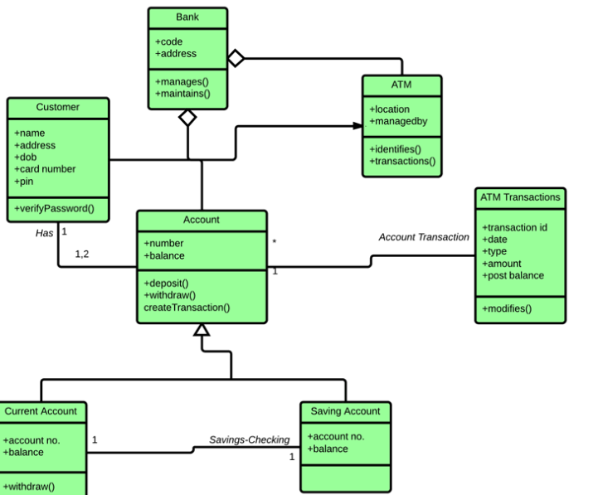

Slide 19
This class diagram represents a banking system with several key entities and their relationships. Here's a breakdown of the diagram:
Customer Class:
Attributes: name, address, dob (date of birth), card number, pin.
Methods: verifyPassword() (to check if the customer's password is correct).
Has a relationship with the Account class, meaning each customer has one or more accounts.
Account Class:
Attributes: number (account number), balance.
Methods: deposit(), withdraw() (methods to add and withdraw money), createTransaction() (to create an account transaction).
Has a relationship with Account Transaction and is linked to ATM Transactions (indicating each account can have multiple transactions).
Bank Class:
Attributes: code, address.
Methods: manages(), maintains() (methods related to managing and maintaining the bank's operations).
Manages the ATM and Accounts. A bank can manage many ATMs and accounts.
ATM Class:
Attributes: location.
Methods: identifies() (identifies users), transactions() (handles transactions).
Managed by the Bank (indicating that ATMs are managed by a bank).
ATM Transactions Class:
Attributes: transaction ID, date, type, amount, post-balance (balance after transaction).
Methods: modifies() (modifies transaction data).
Has a relationship with Account and Transaction classes, meaning each transaction is linked to a specific account and can modify the balance.
Account Transaction Class:
Attributes: links between the Account and ATM Transactions, handling the creation and modification of account transactions.
Current Account Class (Subclass of Account):
Additional attributes: account number, balance.
Methods: withdraw() (withdraw money from the current account).
Saving Account Class (Subclass of Account):
Similar to the Current Account, but can have different rules for balance and withdrawals.
Relationships:
Customer "Has" Account: A customer can have one or more accounts.
Bank "Manages" ATM and Account: A bank manages many ATMs and accounts.
ATM "Identifies" Customer and Performs Transactions: The ATM identifies the user and handles transactions.
Account "Has" ATM Transactions: Each account is involved in multiple ATM transactions.
Key Points:
Inheritance: The Current Account and Saving Account are specialized versions of the Account class.
Associations:
A customer can have multiple accounts.
An account can be associated with many transactions, which can be processed by an ATM.
Methods: Each class has specific methods related to its functionality, like depositing money, withdrawing, verifying a password, and managing transactions.
This class diagram shows the structure and relationships between the customer, accounts, bank, ATM, and transactions in a banking system.

